Slide 1
Hypertrophic Scars and Keloids
Review and Case presentation
By
Tarek A Abulezz MD

Slide 2
http://www.healioswoundsolutions.com/management-hypertrophic-scars-keloid/

Slide 3
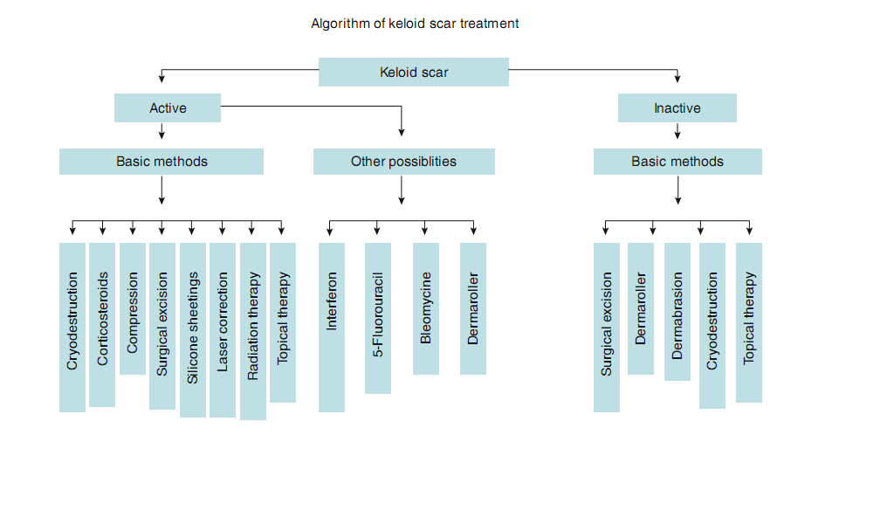

Slide 4
Introduction
Keloidal scarring is one of the most frustrating clinical problems in wound healing.
Keloids form following dermal injury and exhibit exuberant, indefinite growth of collagen.
They tend to occur in darker skinned individuals with a familial tendency and not in the extremes of age.

Slide 5
Introduction
Keloid formation has been ascribed to altered growth factor regulation, aberrant collagen turnover, genetics, immune dysfunction, sebum reaction, and altered mechanics.
No single unifying hypothesis adequately explains keloid formation.

Slide 6
Surgical excision
Surgical excision of a hypertrophic scar gives satisfactory results. However, surgical excision of keloids by itself generally results in lesion recurrence. The recurrence rates of 40 to 100 percent.
Simple excision is believed to stimulate additional collagen synthesis,resulting in rapid regrowth and often a larger keloid. Surgical excision of a keloid scar as a single method without another method causes a relapse in 85–100 % of cases .

Slide 7
Surgical excision
During the postoperative period, the scar is treated as a potential keloid, involving the application of a number of treatments: corticosteroids, compression therapy, silicone sheeting and gels.
Subtotal excision along with lateral undermining has been credited with improved outcome and fewer recurrences . Because the rim of the keloid scar serves to splint the wound and relieve tension, the stimulus for collagen synthesis is decreased.

Slide 8
Surgical excision
Surgical excisions can be closed either primarily or through a number of reconstructive techniques.
In general, sutures are removed as early as possible and intradermal, subcuticular closure is preferred, to avoid suturemarks that subsequently develop keloids.
Monofilamentous suture is preferred to braided suture to minimize local inflammatory reaction.
If primary closure does not suffice, the wound from the surgical excision of keloids can be closed with flap advancement, autograft.

Slide 9
Prevention
The initial surgical debridement must be carried out during the ﬁrst few hours after the moment of injury.
The goal of such debridement is to stop hemorrhage, remove any extraneous matter from the wound, ﬁx and immobilize the wound edges, take preventive measures to ﬁx edema, and stop any septic inﬂammation.
As a rule, the delayed initial surgical debridement results in formation of hypertrophic and keloid scars .

Slide 10
Prevention
Inadequate immobilization of the scar region or lack of ﬁxation results in continuous movement of the wound edges in all three planes: vertical, horizontal and sagittal.
Eventually, the edges of the scar start spreading, and the bottom of scar begins to sag; a defect is formed that is to be “patched” by the skin.
This leads to proliferation of ﬁbroblasts in the scar region and to intensiﬁcation of collagen synthesis resulting in formation of a hypertrophic or keloid scar.

Slide 11
Prevention
In case of introduction of irritating materials or surface active materials to the wound or in case of protracted contact of such materials with the wound, such active substances create a focus of chronic inﬂammation in the region of scar formation. The duration of scar cicatrization and maturation increases. Therefore, hypertrophic scars are formed.
Keloids are frequently formed in the course of tattooing. In this case, a pigment functions as an irritating agent; however, relevant trauma plays the leading role in this process.

Slide 12
Keloid Vs Hypertrophic Scar
Keloids and hypertrophic scars are separate clinical and histochemical entities. Clinically, hypertrophic scars remain within the confines of the original scar border, whereas keloids invade adjacent normal dermis.
Hypertrophic scars generally arise within 4 weeks, grow intensely for several months, and then regress. In contrast, keloids may appear later following the initial scar and then gradually proliferate indefinitely.

Slide 13
Keloid Vs Hypertrophic Scar
Although both keloids and hypertrophic scars show increased fibroblast density, only keloids have increased fibroblast proliferation rates.
Collagen fibers in keloids are larger, thicker, and more wavy than those found in hypertrophic or normal scars and assume a random orientation, whereas those in hypertrophic scars orient parallel to the epidermal surface.

Slide 14
Dermaroller Collagen induction therapy
The dermaroller method is applied for treatment and correction of inactive keloids and hypertrophic scars in any region of the human body.
In this case, depending on the thickness, prescription, and location of the scar, a dermaroller with needles from 0.5 to 2.5 mm long are used.
Dermaroller’s microneedles penetrate into the skin up to the mesoderm and mechanically destroy the scar tissue ﬁbers.

Slide 15
Dermaroller Collagen induction therapy
Fibroblasts have to “patch” the defects remaining after the microneedles. At this point, the ﬁbroblasts produce collagen islets: the more punctures there are in the skin, the more islands of young collagen are synthesized.
Thus, the ﬁbers of old collagen are destroyed, and replace by new fibers, which are parallel to the surface of the skin.

Slide 16
Fluorouracil, Bleomycin
Some cytostatic drugs are effective in the treatment of keloid and hypertrophic scars because of their ability to suppress cell proliferation.
The mode of action of these preparations is not sufﬁciently researched. 5-Fluorouracil is the antimetabolite of uracil and competes with it for thymidylate synthase. It blocks the synthesis of DNA cells, causing the formation of structurally imperfect RNA, which causes suppression of ﬁbroblast division.

Slide 17
Fluorouracil, Bleomycin
Injection : Give a single intralesional injection of 50–100 mg of 5- ﬂuorouracil per week. The course of treatment lasts for 8–12 weeks.
Injection of equal quantity of 5 FU and corticosteroid gives the fastest results.

Slide 18
Fluorouracil, Bleomycin: side effects
The main side effects of this treatment method are painful injections, hyperpigmentation; in rarer cases, there are scabs and ulceration.
The intralesional injections of preparation cause much pain, sometimes to the extent that it complicates the therapy treatment.

Slide 19
Dermabrasion
Microdermabrasion with hypertrophic scars does not give any substantially tangible results; hence, it does not descend below the dermal papillae. In the course of active keloid treatment it may even provoke keloid growth.
Rotation dermabrasion for hypertrophic scars gives positive results only with reiterative application; if applied to keloids, it may provoke their growth. Nevertheless, sandabrasion may be applied for the correction of old, inactive keloids.

Slide 20
Dermabrasion
Application of multiple procedures (six to eight with the interval of 1–1.5 months) results in decreased scar mass, increased elasticity, and decreased hyperpigmentation.
However, the application of this method in the décolleté zone may provoke swelling and activation of the scar.

Slide 21
Dermabrasion
Sand abrasion is performed by abrasive disks with sand bonded to their surface (as sandpaper). Depending on the grit size, different abrasive disks have different numbers (from No. 80 for the extra coarse to No. 240 for ultra ﬁne).
For facial scars, abrasion with 120- to 240-grit is to be applied. If the lesion does not go further than epidermis, super ﬁcial dermabrasion is applied.
In case of a deeper lesion (affecting the papillary layer), so-called deep dermabrasion is to be performed.

Slide 22
Compression Therapy
Continuous compression of 20–40 mmHg is applied for 12–24 h/day for 3–12 months. On the one hand, it resists the scar tissue growth, holding it mechanically within the range of limited space; on the other, by putting pressure on the scar vessels, it blocks nutrition, which results in termination of growth or partial regression.
Synthesis of collagen is an oxygen-dependent process, as opposed to its dissociation. By forming local ischemia, we hamper collagen synthesis and maintain its disintegration (biodegradation).

Slide 23
Compression Therapy: Side effects
In the course of durable application, there may appear maceration, infection, folliculate, milia, and dermatitis.
Introduction of durable compressions and the limitation in movement that results may provoke muscular atrophy when applied to children.
In case of prolonged pressure on the joint areas, necrosis and osteoporosis of bones may form. All such complications are connected with the prolonged term of treatment.

Slide 24
Silicone containing substances
Silicone containing substances are mainly applied in the form of silicone sheeting or gels. Gels are applied on the face and neck and in the area of joints, where silicone sheeting cannot be ﬁxed.
The silicone coatings do not affect the scar directly. The mechanism of their effect has not been investigated to its core, but the following scheme is assumed: scar hydration → capillary compression → decreased level of cytokine delivery → decreased collagen synthesis .

Slide 25
Silicone containing substances
Use of silicone gel either as a topical gel or impregnated elastic sheet requires covering the entire scar for at least 12 hours each day, and ideally 24 hours per day except when the skin is being cleaned .
Silicone gel can be used alone or as adjuvant therapy after excision and is effective after 4 to 6 months of treatment.

Slide 26
Silicone containing substances
Adverse effects of silicone gel include occasional skin maceration, erosion, rash, and pruritus, all of which resolve with removal of the gel for several days followed by reapplication.

Slide 27
Cryosurgery
Cryosurgery is successfully used for treatment and correction of hypertrophic scars and keloids.
The ﬁrst method (“application method) is implemented by means of contact in ﬂuence. In the ﬁrst stage, the cryogenic agent cools the special metal tip (Cryosurgical Closed Probes), which ensures freezing of the tissue. To carry out this procedure, special Cryosurgical Closed Probes of various forms and dimensions are used.

Slide 28
Cryosurgery
The second method (“open spray method”) freezes with the help of spraying. The cryogenic agent, after vaporization, is directed to the tissue in the form of a thin gaseous spray and freezes it.
The third method (“reed method”) is based on the utilization of a cotton wool or gauze swab, which is closely turned around a wooden stick and moistened in liquid nitrogen.

Slide 29
Cryosurgery
The reed method and open spray method are not used in the course of treatment and correction of keloids as they cannot create the necessary compression and prolonged exposure of the continuously low temperature.
Such tissue processing results in the increase of activity of ﬁbroblasts instead of the destruction of ﬁbroblasts; collagen synthesis is increased by two to three times, and the scar continues to grow.
Therefore, only one method may be utilized for the treatment of keloids: cryoapplication by the use of Cryosurgical Closed Probes.

Slide 30
Cryosurgery
Cryodestruction is implemented using Cryosurgical Closed Probes for two to three cryocycles, 20–40 s each.
After several days, a crust forms on the treated surface.
After removal of the crust, the scar mass decreases.
This procedure is to be repeated after 3–4 weeks.
To obtain an obvious result, it is necessary to carry out eight to ten procedures (as a minimum)

Slide 31
Cryosurgery: Contraindications, Side Effects, Complications
Contraindications are cold urticaria and the low pain limit.
The main side effects are skin atrophy and depigmentation . Melanocytes are situated more superﬁcially than the ﬁbroblasts and the collagen ﬁbers; therefore, they are the ﬁrst to die off.
Keloid treatment used as a single treatment method results in 51–84 % recrudescence; hence, it is applied in combination with other methods. The hypertrophic scars respond to treatment much better:
They require a shorter exposition period (15–30 s), fewer cryocycles, and fewer repeated procedures (as a rule, three to four procedures applied at a time interval of 3–4 weeks is enough). A positive result is observed in 75–85 % of treatment cases.

Slide 32
Radiation
Radiation therapy effectively reduces keloid recurrence rates. Its use has been limited by the theoretical risk of inducing malignancy.
Radiation therapy as an adjunct to keloid ex cision has efficacy rates of 65 to 99 percent in long-term follow-up.
Radiation of keloids damages the fibroblasts directly and affects collagen structure and organization.

Slide 33
Relapse Prevention Measures
It is necessary to apply conservative therapy prior to surgical excision; this therapy will include corticosteroid injections, x-ray therapy, and cryodestruction.
Wound closure is planned precisely with minimum tension in parallel with RSTLs.
If necessary, use deep adaptation stitching for layer speciﬁc closure and decreased stretch tension in the wound area.

Slide 34
Relapse Prevention Measures
Apply pressure bands and compression underwear in the early stages of the postoperative period.
Intramarginal corticosteroid injections into the wound are made while the patient is on the surgical table.
Postoperative radiation is to be started during the ﬁrst 24 h after the surgical operation. Total dose is no less than 12 Gy.

Slide 35
Relapse Prevention Measures
Application of Imiquimod cream must be started the ﬁrst night after the surgical operation and continued for the following 8 weeks.
During the ﬁrst year after surgical operation, visiting a solarium or sauna or taking hot baths is not recommended because thermal procedures stimulate blood ﬂow in the scar area, which can provoke its growth.

Slide 36
AntiHistamines
Histamine antagonists, particularly anti-H1, can relieve some of the burning and pruritus and may modulate keloid size.
The problematic pruritus of keloids probably results from mast cell degranulation and histamine release.
Histamine may also contribute to keloid formation through stimulation of collagen synthesis and other processes.

